Slide 1
SMART WATER FOUNTAINS
PHASE-5 PROJECT
BY,
J.SAINANTHAN
A.YOGESH
S.M.RAGUL PRASATH
S.SUJITH
SOUNDHAR PANDIYAN

Slide 2
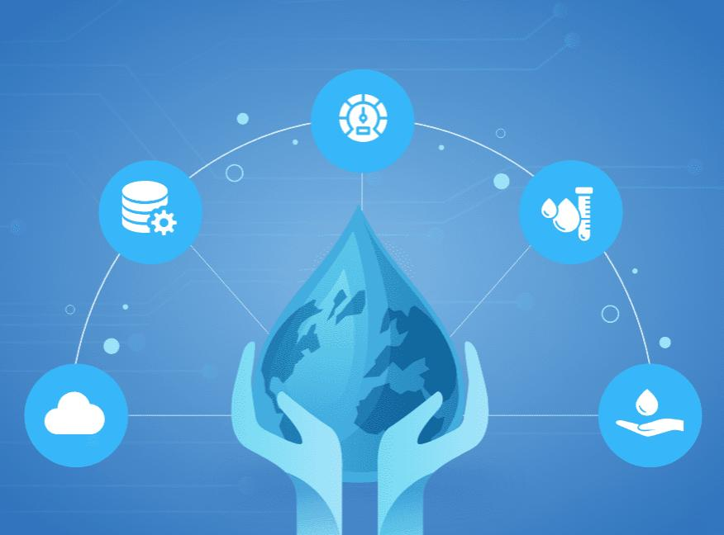
objective
Nowadays, the internet of things has been improved greatly with the progress of the sensor, big data, mobile Internet and other relative technologies. One water fountain with intelligent monitoring system based on the internet of things is discussed in this paper. The key parameters of the water fountain were derived from the sensors and transmitted the encrypted data by GPRS or WIFI net to central server automatically. The Access database was established according to the real time running data of each water fountain fixed everywhere.

Slide 3
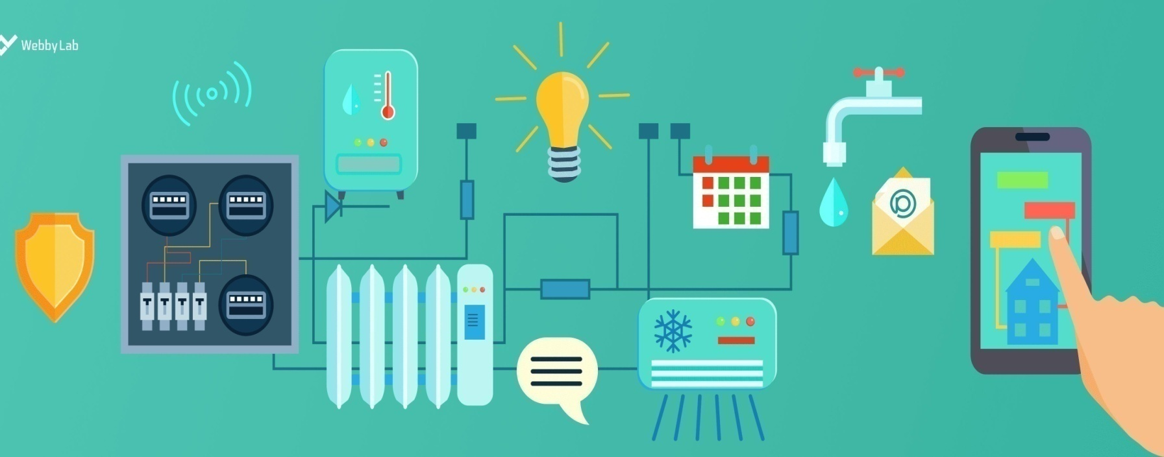
Smart Water Fountation
A smart water fountain is a technologically advanced version of a traditional water fountain, equipped with various features and sensors to enhance its functionality and user experience. Smart water fountains are becoming increasingly popular in both residential and commercial settings due to their convenience, energy efficiency, and the ability to provide clean and customizable drinking water. They offer a modern and sustainable solution for staying hydrated. Here are some key aspects of a smart water fountain:
Automated Dispensing
Filtration and Purification
Temperature Control
Touchscreen Interface
Water Usage Tracking
Mobile App Integration
Energy Efficiency
Data Collection

Slide 4

IOT Sensor on smart water fountation
Setting up an IoT (Internet of Things) sensor system for a smart water fountain involves several components and steps. Here's an overview of how you can set up the IoT sensor system for a smart water fountain
Select Sensors:
Choose the appropriate sensors based on the desired functionalities. Common sensors for a smart water fountain might include:
Water level sensor: To monitor the water level and prevent overflows.
Temperature sensor: For controlling and monitoring water temperature.
Flow sensor: To measure water flow rate.
Water quality sensor: For checking water quality and purity.
Motion/proximity sensor: To enable touchless operation.
UV-C sensor (if UV-C sterilization is used): To monitor UV-C lamp status

Slide 5
IoT Hardware:
Select IoT hardware components such as microcontrollers or development boards (e.g., Arduino, Raspberry Pi) that are compatible with your chosen sensors.
Ensure your hardware has Wi-Fi or other connectivity options (e.g., Bluetooth, LoRa, cellular) to transmit data to the cloud.
Power Supply:
Consider power requirements for your IoT setup. Depending on the sensors and microcontroller used, you may need a reliable power source, which could be a battery, power adapter, or a combination of both.
Connectivity:
Set up a secure and reliable network connection for your IoT device. This may involve configuring Wi-Fi credentials or setting up cellular connectivity.
Programming:
Write code to read data from the sensors and transmit it to the cloud. Use appropriate programming languages and libraries compatible with your IoT hardware.
Maintenance and Updates:
Regularly maintain and update the IoT sensor system to ensure it operates reliably and securely.
Monitor sensor health and replace or calibrate sensors as needed.
Once your IoT sensor system is set up, your smart water fountain should be capable of providing real-time data monitoring and control, making it convenient and efficient for users while offering insights for maintenance and optimization.

Slide 6
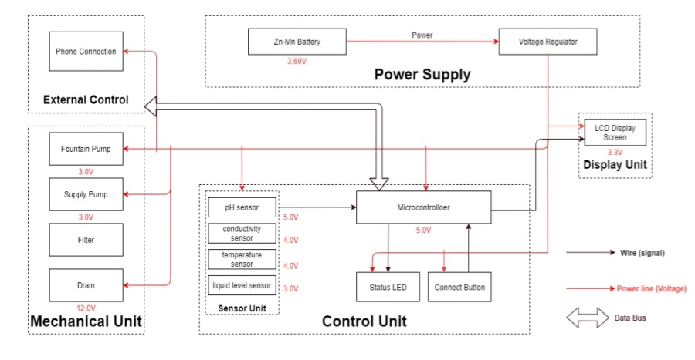
Block diagram of smart water fountation

Slide 7
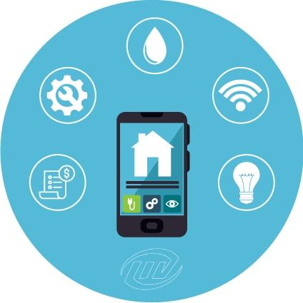
Mobile development using smart water fountation
Developing a mobile app for Smart Water Fountains enhances user interaction and control. Creating a mobile app for Smart Water Fountains requires a multidisciplinary team, including developers, designers, and quality assurance testers. Collaboration and thorough testing are essential to deliver a reliable and user-friendly application.Here's a step-by-step guide to developing such an app:
Define Objectives
Choose Platforms
Technology Stack
User Interface (UI) Design

Slide 8
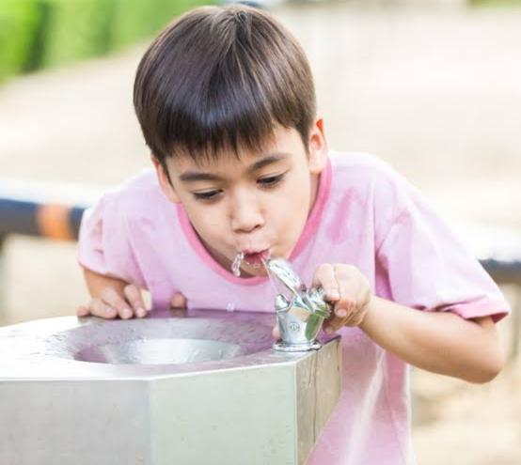
Features and Functionality:
Implement the desired features, such as:
User registration and authentication.
Real-time data visualization (e.g., water temperature, quality).
Water dispensing controls (adjusting temperature, flow rate).
Push notifications for maintenance alerts or status updates.
Integration with IoT sensors and cloud backend.
IoT Integration
Connectivity
Testing
Security
User Support
Data Privacy Compliance
Marketing and Promotion:

Slide 9
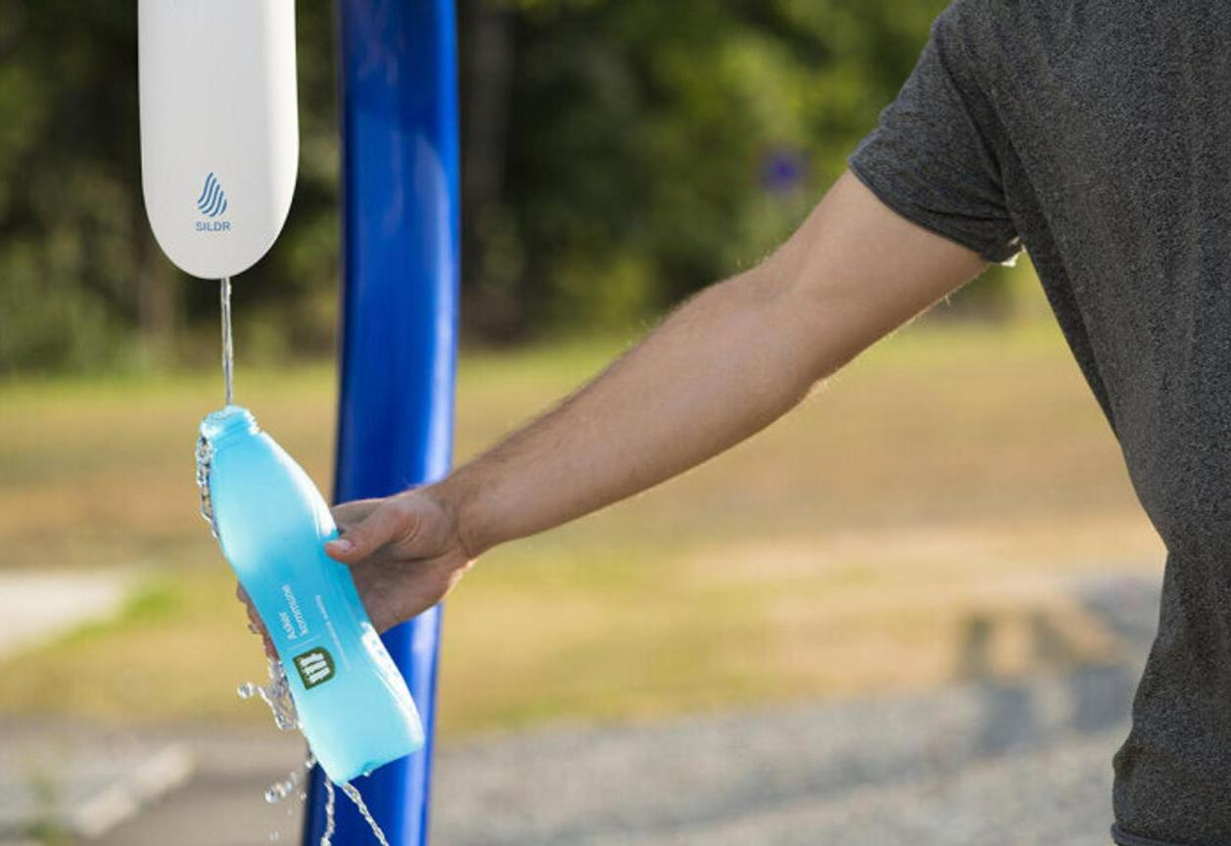
Smart water fountation for public
Smart water fountains for public use offer a range of benefits, including enhanced user experience, improved sustainability, and data-driven insights for facility management. Public smart water fountains are a valuable addition to public spaces, promoting sustainability, public health, and data-driven resource management. They offer an eco-friendly and convenient way for people to stay hydrated while reducing the environmental impact of bottled water consumption.

Slide 10
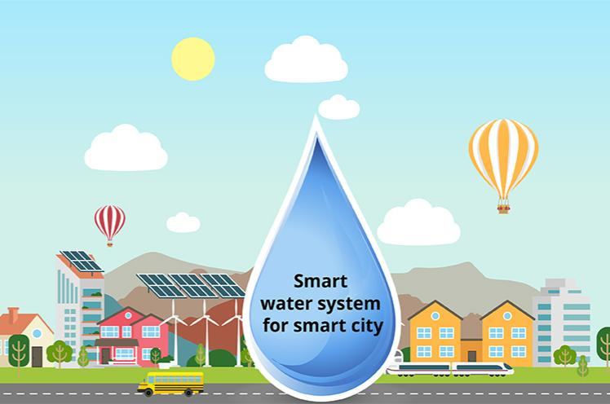
Here are some key considerations and features for smart water fountains in public spaces:
Water Filtration and Purification
Touchless Operation
Temperature Control
Water Bottle Refilling
Hydration Monitoring
Maintenance Alerts
Water Quality Monitoring
Smart Analytics
Mobile App Integration
User Feedback

Slide 11
About Water Monitoring System
The Energyly Water Monitoring System gives you the power to monitor your water usage, by combining software, hardware, wireless communications and sensors, Energyly industry-leading IoT water monitoring and analytics solutions help industries and hotels to increase productivity, and compliance while enhancing safety, sustainability and service
Energyly water monitoring solutions help industries and hotels to meet the wide array of challenges from water monitoring, leakage detection, water pressure management (reducing water pressure from 70 to 50 psi could lower the total water consumption of an industry by 10 to 20%), sewer overflows and flooding to water quality, water meter data collection.

Slide 12
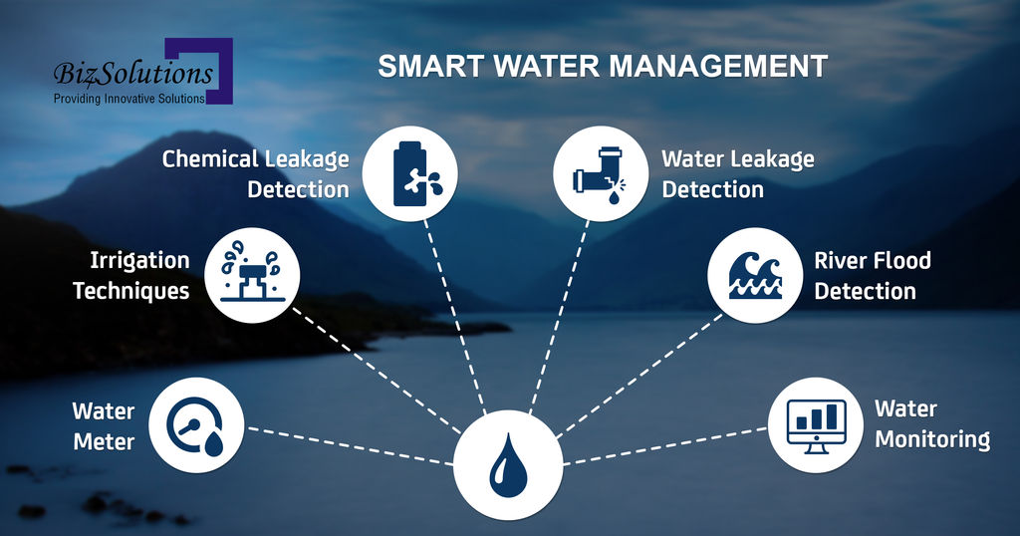
Benefits of IoT Water Monitoring System
Water consumption is recorded in real time—24/7/365.
20% reduction in water consumption
Reduced energy bills
Intelligent water leakage detection and automatic alerts are sent out immediately.
Pressure and water consumption Management
Tell in advance potential failures
Decrease maintenance & repair Cost
Remotely Control IoT Valves

Slide 13
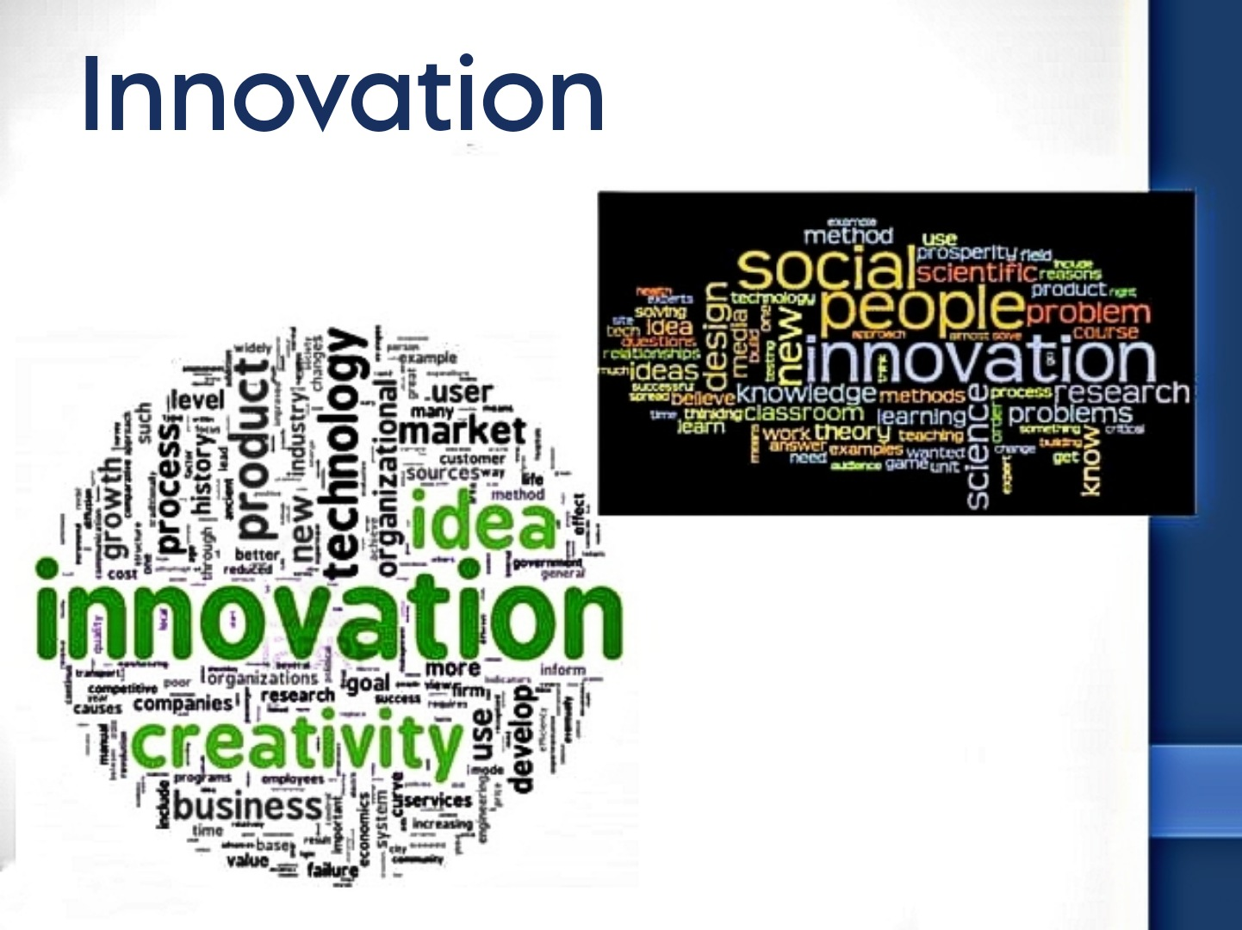

Slide 14
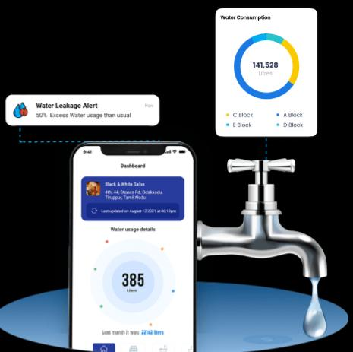
Innovations and ideas of Smart Water Fountation
Real-Time Water Quality Monitoring: Integrate sensors to monitor water quality in real-time, providing users with information about impurities and contaminants in the water.
Solar-Powered Fountains: Create water fountains powered by solar energy, making them energy-efficient and environmentally friendly.
Smart Bottle Refill Stations: Develop smart refill stations that detect and refill reusable water bottles automatically, promoting the use of eco-friendly containers.
Hydration Tracking: Implement sensors that can measure water intake and sync with health apps to provide users with personalized hydration recommendations.

Slide 15
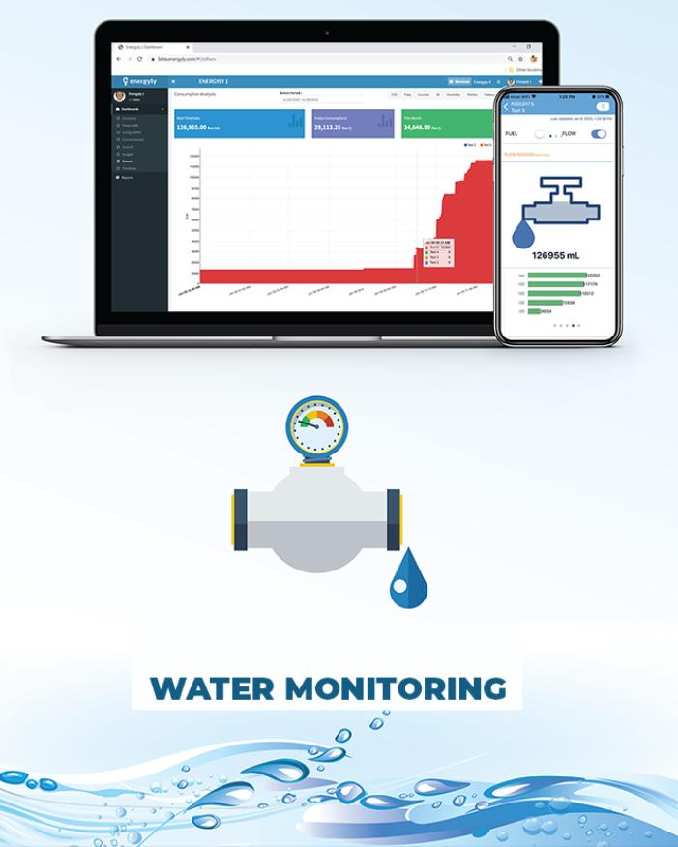
Gesture-Controlled Fountains: Design fountains that respond to gestures, allowing users to control the water flow and temperature with simple hand movements.
Water Saving Modes: Include intelligent water-saving modes that adjust water flow based on the demand, optimizing water usage in different scenarios.
Educational Displays: Incorporate interactive screens that display information about the importance of hydration, local water sources, and environmental impact, raising awareness among users.
Mobile App Integration: Create dedicated mobile apps that allow users to locate nearby smart water fountains, check water quality reports, and receive notifications when they need to hydrate.

Slide 16

Voice Command Integration: Enable voice-activated controls, allowing users to operate the fountain and access information through voice commands, enhancing accessibility.
Aromatherapy Infusion: Introduce aromatherapy features that allow users to infuse water with natural scents, providing a refreshing and pleasant drinking experience.
Emergency Response System: Include a panic button or sensor that, when activated, dispenses clean drinking water, aiding in emergency situations and natural disasters.
Smart Payment Integration: Implement contactless payment systems for paid water dispensing, enabling users to pay through mobile wallets or contactless cards.
Interactive Art Installations: Combine water fountains with interactive art installations, creating visually appealing and engaging public spaces that also serve a functional purpose.
Weather-Responsive Controls: Integrate weather sensors to adjust water temperature and flow rate based on the ambient temperature, ensuring users receive comfortable and refreshing hydration.
Customizable Designs: Offer customizable designs for smart water fountains, allowing cities and businesses to incorporate their branding, fostering a sense of community ownership.These ideas leverage technology and creativity to enhance user experience, promote hydration, and contribute to sustainable practices.

Slide 17
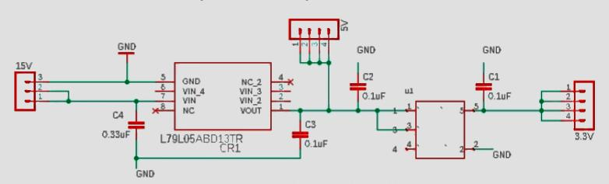
Circuit Diagram

Slide 18
Certainly! A smart water fountain system typically involves several components to function effectively. Here's a simplified circuit diagram explanation of a basic smart water fountain system:
Water Pump: The heart of the system, the water pump, is responsible for circulating water through the fountain.
Water Level Sensor: A sensor is used to detect the water level in the fountain. It ensures that the pump operates only when the water level is above a certain threshold to prevent damage.
Microcontroller (e.g., Arduino or Raspberry Pi): The brain of the system, the microcontroller processes data from sensors and controls the operation of the water pump and other components.

Slide 19
Wi-Fi Module (e.g., ESP8266 or ESP32): This module enables the system to connect to the internet and communicate with other devices or applications, allowing for remote control and monitoring.
Mobile App/Cloud Server: The user interacts with the system through a mobile app or a web interface, allowing them to control the fountain remotely, monitor water levels, and set various parameters.
Relay Module: A relay module acts as a switch controlled by the microcontroller. It's used to turn the water pump on or off based on the input from the water level sensor and user commands from the app.
Power Supply: Provides the necessary power to the components in the circuit, usually with appropriate voltage and current ratings.

Slide 20
Program:
class SmartWaterFountain: def __init__(self): self.water_level = 100 # Initial water level in the fountain def refill_fountain(self, amount): self.water_level += amount print(f"Water fountain refilled with {amount} liters. Current water level: {self.water_level} liters") def dispense_water(self, amount): if self.water_level >= amount: self.water_level -= amount print(f"Dispensed {amount} liters of water. Current water level: {self.water_level} liters") else: print("Not enough water to dispense.") if __name__ == "__main__": fountain = SmartWaterFountain()

Slide 21
while True: print("\n1. Refill Fountain") print("2. Dispense Water") print("3. Exit") choice = input("Enter your choice: ") if choice == '1': amount = int(input("Enter the amount to refill (liters): ")) fountain.refill_fountain(amount) elif choice == '2': amount = int(input("Enter the amount to dispense (liters): ")) fountain.dispense_water(amount) elif choice == '3': print("Exiting the program.") break else: print("Invalid choice. Please try again.")

Slide 22

Output:
1. Refill Fountain 2. Dispense Water 3. Exit Enter your choice: 1 Enter the amount to refill (liters): 50 Water fountain refilled with 50 liters. Current water level: 150 liters 1. Refill Fountain 2. Dispense Water 3. Exit Enter your choice: 2 Enter the amount to dispense (liters): 30 Dispensed 30 liters of water. Current water level: 120 liters

Slide 23
1. Refill Fountain 2. Dispense Water 3. Exit Enter your choice: 2 Enter the amount to dispense (liters): 100 Not enough water to dispense. 1. Refill Fountain 2. Dispense Water 3. Exit Enter your choice: 3 Exiting the program.

Slide 24
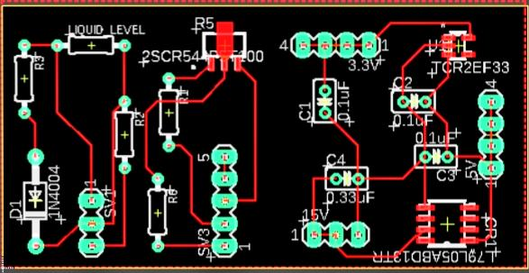
Mechanical Unit PCB Design

Slide 25

Web Development Platform:
There isn't a specific web development platform tailored exclusively for smart water fountain systems. However, you can use popular web development technologies and platforms to create the necessary web interface for your smart water fountain system. Some commonly used technologies include HTML, CSS, JavaScript for front-end development, and frameworks like React, Angular, or Vue.js for building interactive user interfaces.

Slide 26
For the back-end, you can choose from various programming languages such as Python, Node.js, or Java, and use frameworks like Django, Express.js, or Spring Boot. Additionally, you might need a database system like MySQL, PostgreSQL, or MongoDB to store data related to the smart water fountain system.
As for the platform, you can host your web application on cloud platforms like Amazon Web Services (AWS), Microsoft Azure, or Google Cloud Platform (GCP). These platforms offer scalable hosting solutions and various services that can support the development and deployment of your smart water fountain system's web interface

Slide 27

CODE:
Step 1: Install Dependencies Run the following command to initialize a new Node.js project and install the required packages: bash npm init -y npm install express body-parser

Slide 28
Step 2: Create Files Create the following files in your project folder: index.html html Copy code <!DOCTYPE html> <html lang="en"> <head> <meta charset="UTF-8"> <meta name="viewport" content="width=device-width, initial-scale=1.0"> <title>Smart Water Fountain System</title> <link rel="stylesheet" href="styles.css"> </head>
<body> <h1>Smart Water Fountain System</h1> <button id="toggleButton">Toggle Fountain</button> <script src="script.js"></script> </body>

Slide 29
</html> styles.css css body { font-family: Arial, sans-serif; display: flex; flex-direction: column; align-items: center; justify-content: center; height: 100vh; margin: 0; } h1 { margin-bottom: 20px; }
button { font-size: 18px; padding: 10px 20px; cursor: pointer; }

Slide 30
script.js javascript const toggleButton = document.getElementById('toggleButton'); toggleButton.addEventListener('click', () => { // Logic to toggle the fountain console.log('Fountain toggled'); // You can send an API request to the back-end here to control the fountain }); server.js javascript Copy code const express = require('express'); const bodyParser = require('body-parser'); const app = express(); const PORT = 3000; app.use(bodyParser.json());

Slide 31
app.post('/toggleFountain', (req, res) => { // Logic to control the fountain (turn on/off) // You can implement your smart water fountain system logic here // For now, just log the request body console.log(req.body); // Send a response back (you can customize this response based on your system's behavior) res.json({ message: 'Fountain toggled' }); }); app.use(express.static('public')); app.listen(PORT, () => { console.log(`Server is running on port ${PORT}`); });

Slide 32
Step 3: Run the Server Run the server using the following command: bash node server.js Your smart water fountain system website will be accessible at http://localhost:3000. When you click the "Toggle Fountain" button, the front-end JavaScript will send a request to the back-end, triggering the /toggleFountain endpoint. You can implement the logic to control your smart water fountain system inside the /toggleFountain route handler in server.js.

Slide 33
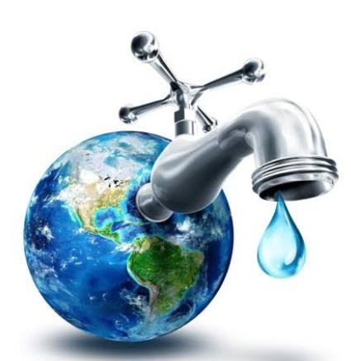
Conclusion:
smart water fountains for public use represent a forward-thinking and sustainable solution to meet the hydration needs of individuals in various public spaces. These innovative fountains offer numerous benefits, making them a valuable addition to urban environments, parks, schools, transportation hubs, and other communal areas.smart water fountains for public use offer a holistic solution that combines convenience, sustainability, and data-driven management to promote hydration, reduce waste, and contribute to the well-being of communities. Their continued adoption in public spaces aligns with the growing focus on environmental sustainability, public health, and smart infrastructure.

Slide 34


